Slide 1

AI-Powered Collections Strategy
Scalable, Ethical, and Impactful
Inputs
Decision Logic
Customer behavior: missed payments, credit utilization
Segment customers by risk tier
Match interventions to risk level (education, outreach, restructuring)
Demographics and engagement history
Model predictions: delinquency risk scores
Actions
Trigger personalized campaigns
Offer financial literacy resources
Flag high-risk accounts for human review

Slide 2








🔁 Learning Loop & Optimization
Feedback Sources
Model Updates
Campaign engagement
Retrain quarterly
Repayment behavior
Adjust thresholds and segments
Customer feedback
Monitor fairness and drift
Data Collection
Analysis
Gather customer behavior and engagement metrics
Process feedback and identify improvement opportunities
Implementation
Optimization
Deploy updated models and monitor performance
Refine models and adjust intervention strategies

Slide 3




🤖 Role of Agentic AI
Autonomous Tasks
Human-in-the-Loop
Governance
Risk scoring
Reviewing edge cases
Decisions logged and auditable
Campaign triggering
Handling escalations
Human override always available
Routine follow-ups
Designing interventions

Slide 4




🛡️ Responsible AI Guardrails
Fairness
Explainability
Behavior-based segmentation
Transparent scoring logic
Bias audits across age, income, location
Clear rationale for interventions
Compliance
GDPR & local data privacy adherence
Opt-out and consent tracking
Ethical AI is not just about compliance—it's about building trust and ensuring fair outcomes for all customers while maintaining the highest standards of data protection and transparency.

Slide 5
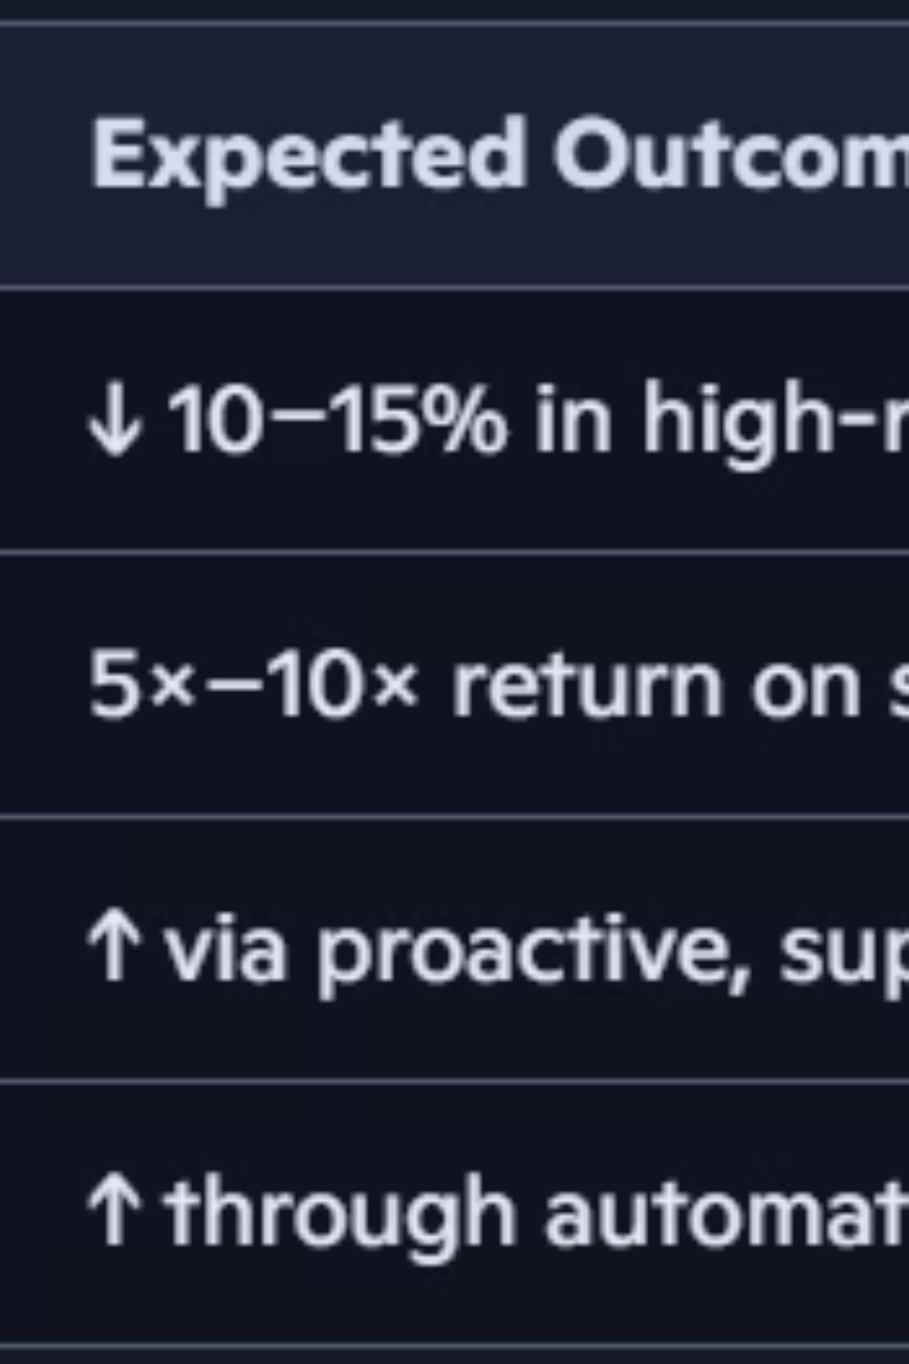
📈 Expected Business Impact
25%
40%
60%
Recovery Rate Improvement
Operational Efficiency
Customer Satisfaction
Automated processes reduce manual workload and accelerate decision-making
Ethical, personalized approach improves customer relationships and retention
Enhanced targeting and personalized interventions drive better collection outcomes
$2M
Annual Cost Savings
Reduced operational costs through intelligent automation and resource optimization
The implementation of AI-powered collections strategy delivers measurable business value while maintaining ethical standards and improving customer experience. This comprehensive approach ensures sustainable growth and competitive advantage in the financial services sector.

